Slide 1
Video Games:
Tech Innovations, Gamification, and The Future

Slide 2
Innovation & Interaction
As mentioned all the way back in week 1, the progression of Vgs as a medium is all about innovation and interaction:
Social: MMOs, The Sims, Warcraft, Minecraft
Mobile: Gameboy, iPhone,
Indie: Steam, Kickstarter
Peripherals: Rock Band, Guitar Hero,
VR: Oculus Rift, Wii
Culture: DOOM, Mortal Kombat, Tomb Raider

Slide 3

Lighting and Physics
The lifeblood of any game engine is its ability to process lighting and physics.
An engine succeeds when the player doesn’t “notice” these details because they have been rendered so realistically.
Dead Island: is it too much to expect a beach ball to ebb and flow with the movement of water?
Dead Island - Beach Ball Physics

Slide 4

“Ragdoll Physics”
Term used in computer/video game animation.
In the past, programmers manually created animations for character death sequences
These sequences usually rendered characters in a stiff and rigid way.

Slide 5
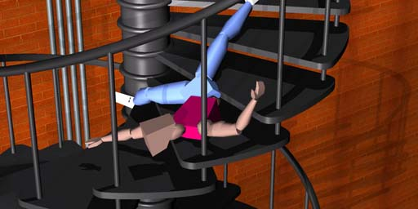
“Ragdoll Physics”
As computers increased in power, it became possible for character bodies to “collapse to the ground,” thereby looking more realistic
The first game to exhibit ragdoll physics was Jurassic Park: Trespasser (1998, PC)
Skyrim Ragdoll Physics Montage

Slide 6
The Uncanny Valley
We’ve already discussed the evolution of graphics in earlier weeks, but as VGs evolve so does their potential for photoreaslism.
Is this the end goal, graphics-wise?
And what about the “uncanny valley”
And of course there is a big difference between in-game animation and pre-rendered cut-scenes!
The Uncanny Valley

Slide 7

Heavy Rain Casting Trailer
Heavy Rain was so proud of its model realism they released a faux “casting trailer,” which looks laughable by today’s standards.

Slide 8
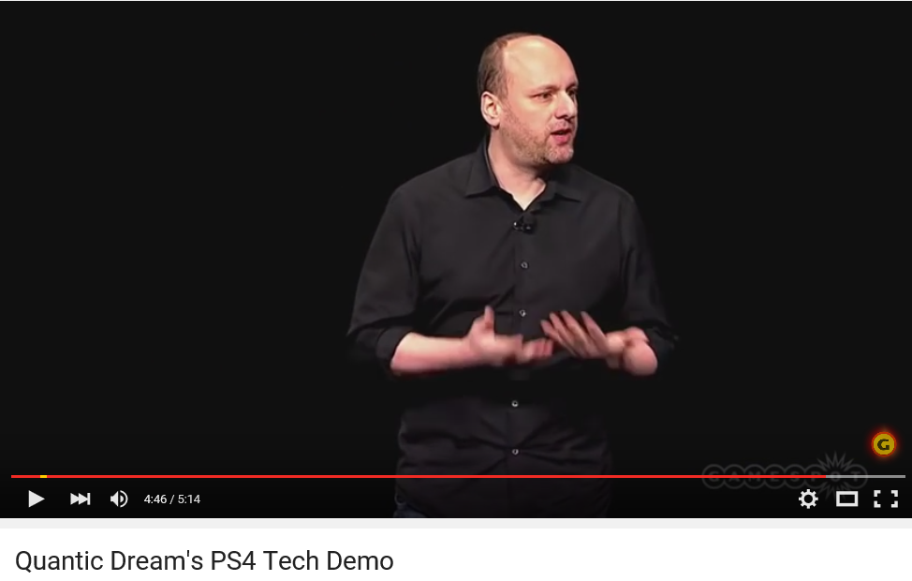
Old man Tech Demo

Slide 9
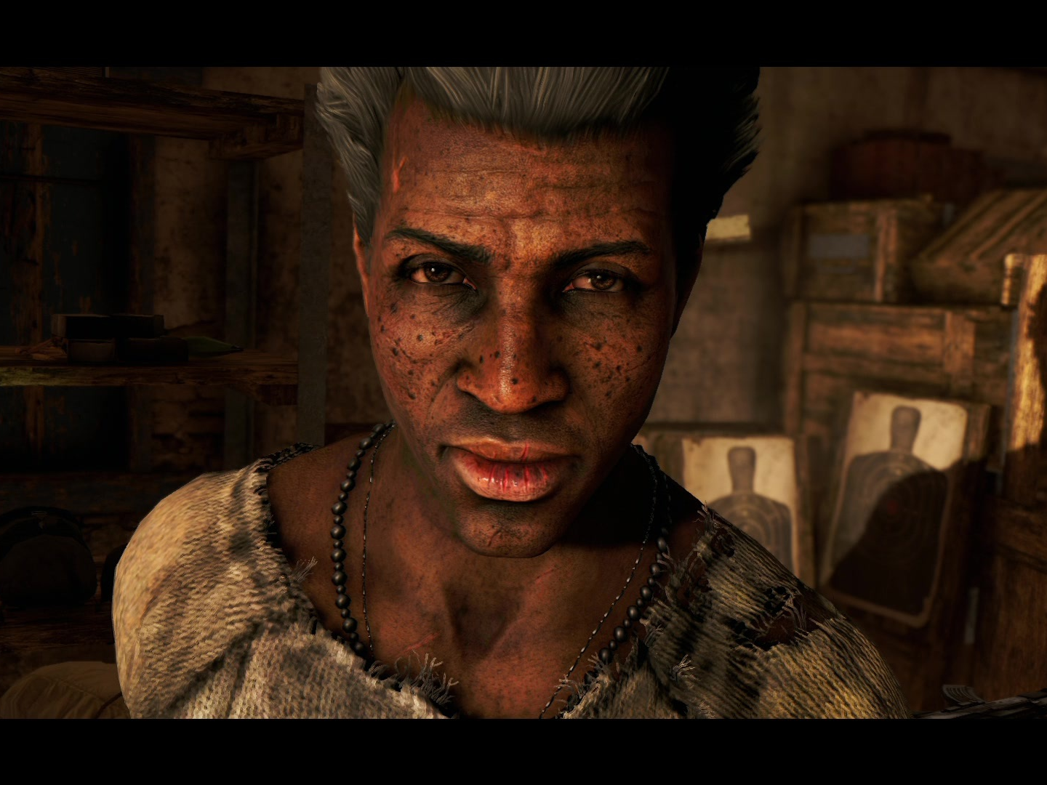
Longinus FARCRY 4

Slide 10


Slide 11
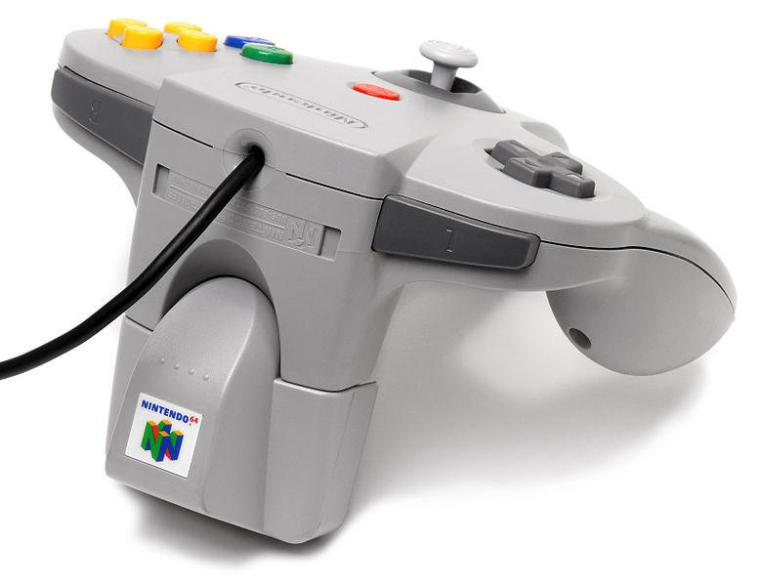
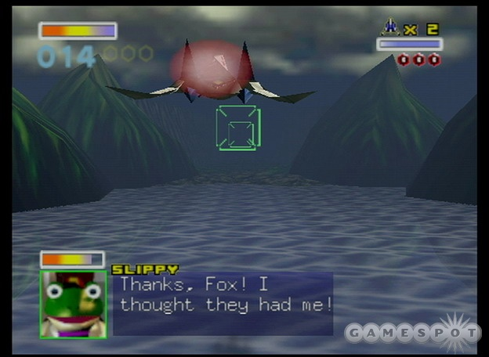
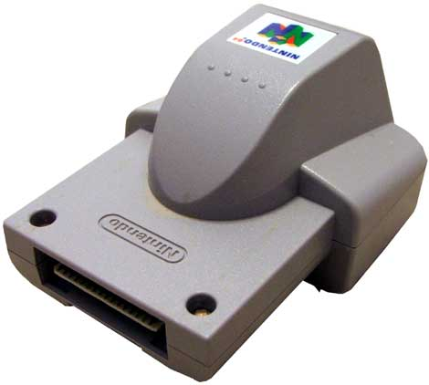
Good Vibrations
The N64 gave us two great video game mainstays: the first was the Rumble Pak.
Caused the controller to vibrate in select situations, such as when firing a weapon or receiving damage, to immerse the player in the game.

Slide 12
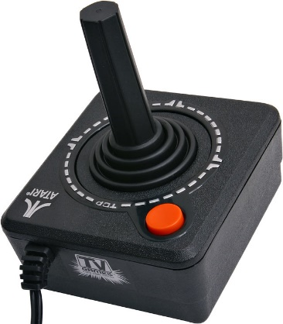
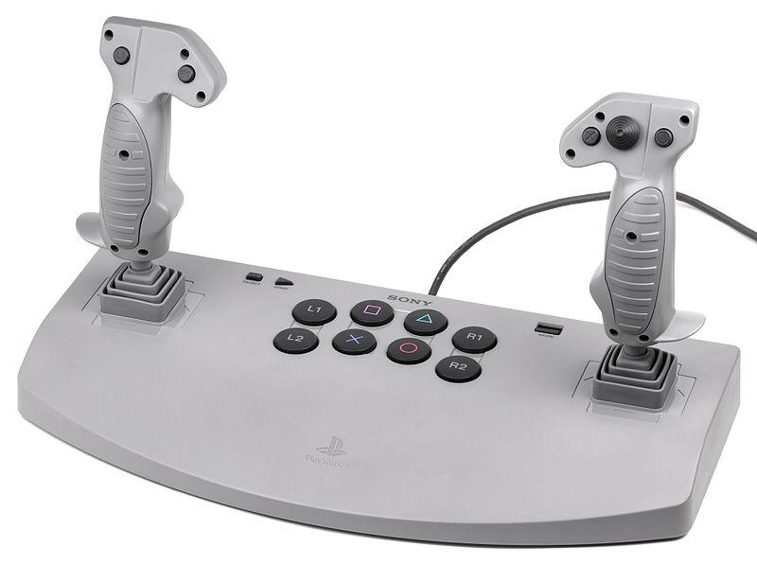
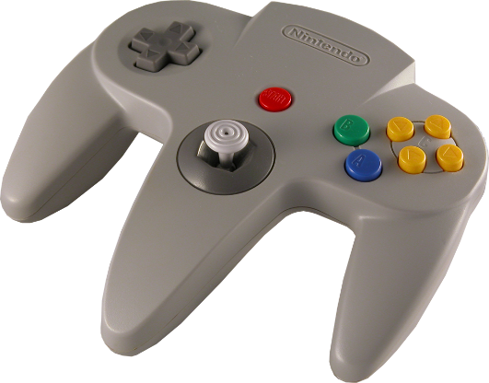
Rumble and Analog
IGN stated it’s influence led to controller vibrations being "an industry standard within a single generation.”
The other great N64 controller innovation was the popularization of the analog stick—also an industry standard (although Nintendo wasn’t the first to use it).

Slide 13
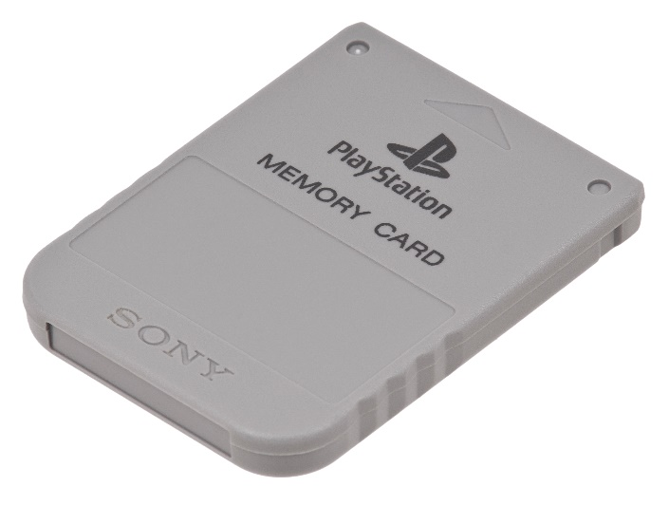
Peripherals
A video game “accessory” outside of the console itself. Can include controllers.
However, throughout the years designers have tried to standardize various peripherals outside of the console/controller combo.
Let’s look at a few of the more famous examples….

Slide 14
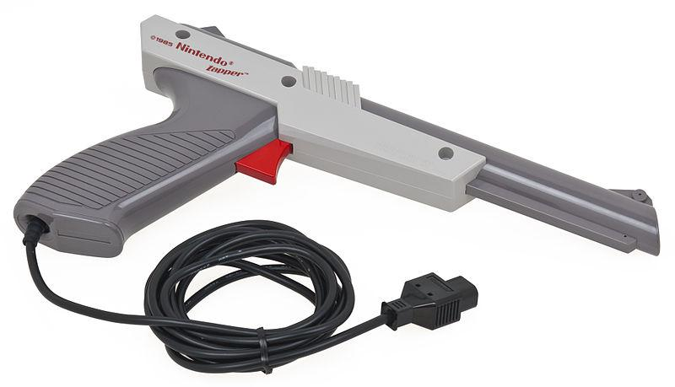
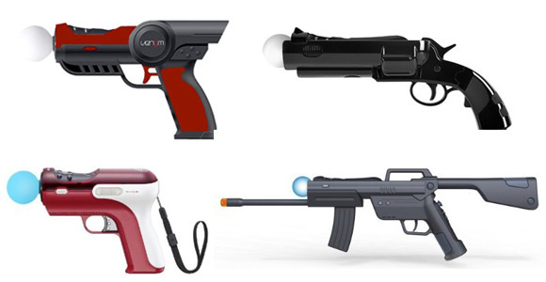
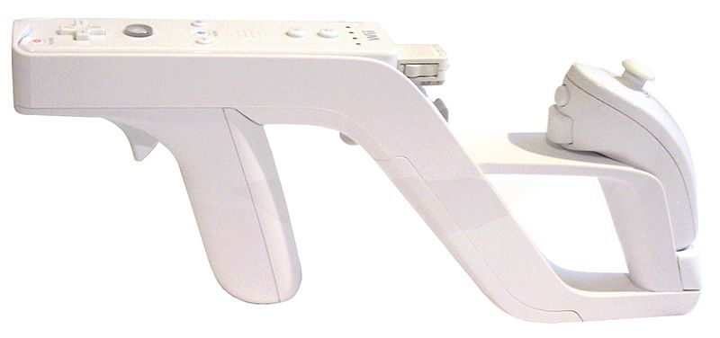
“Light Gun”
Begins in arcades.
Popularized by the NES “Zapper” for Duck Hunt
The Wii Zapper released in 2009.
Light guns still seen as gimmicky.

Slide 15
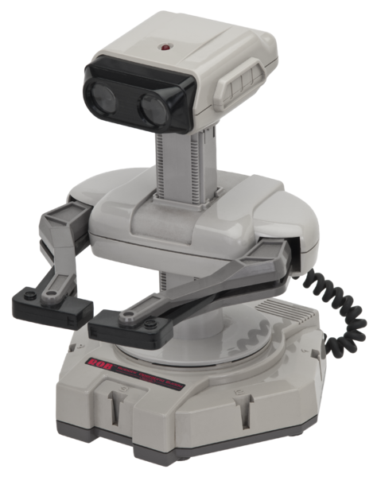
R.O.B. (Robotic Operating Buddy)
Released for the NES in 1985
Famous (or infamous) despite only being used in two games and having extremely limited functionality

Slide 16
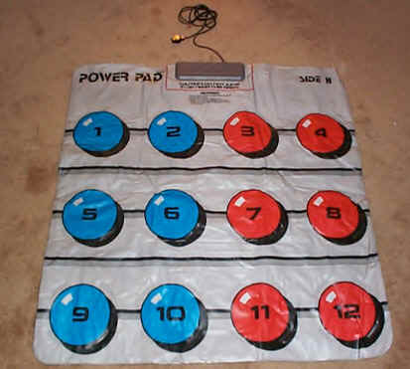
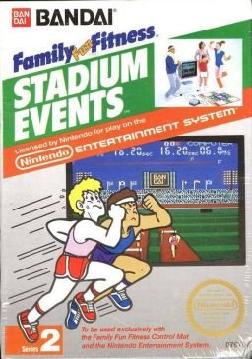
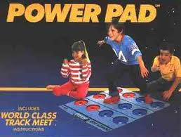
Nintendo “Power pad” (1988)
Floor mat game controller, early precursor to foot coordination games like DDR.
Wasn’t a huge success.

Slide 17
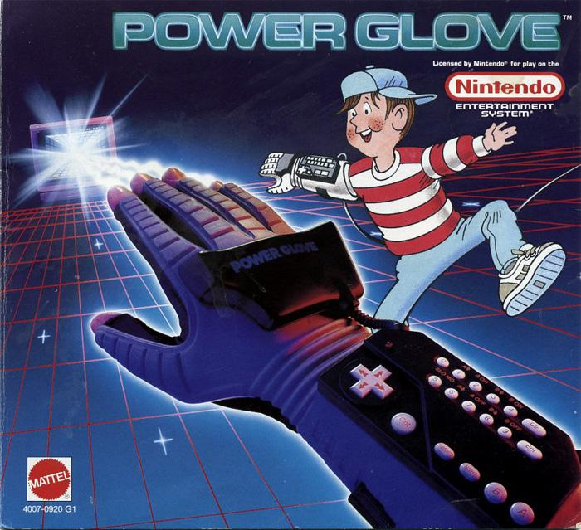
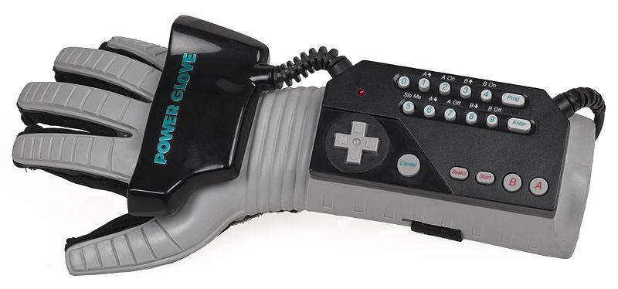
The Power Glove (1989)
First peripheral interface controller to recreate human hand movements on a television or computer screen in real time.
Only 2 games made for it.
Sold poorly.

Slide 18
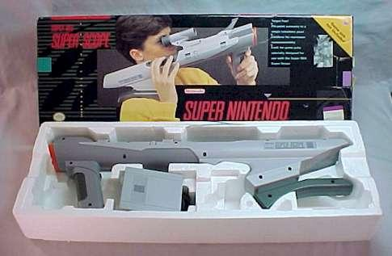
“The Super Scope” (1993)

Slide 19
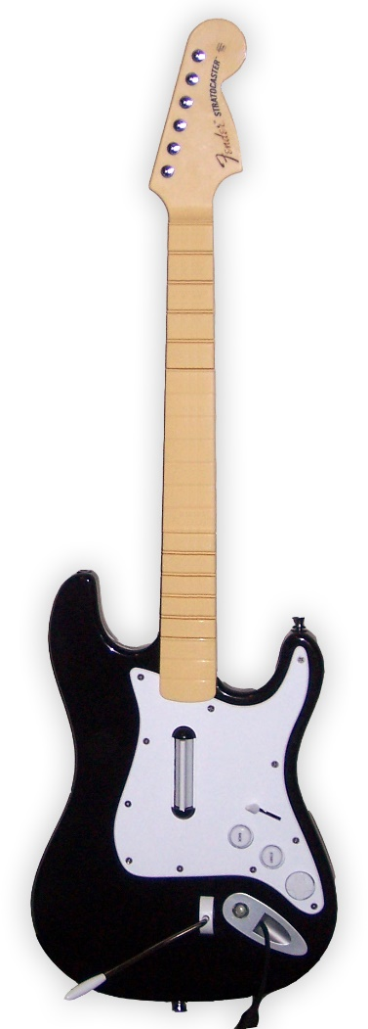
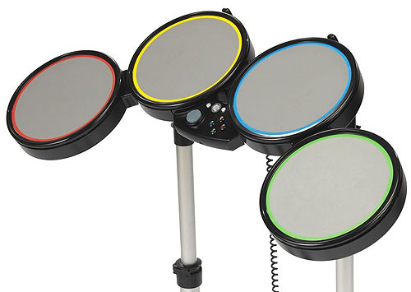
Guitar Hero/Rock Band (2005)
This franchise owes much (if not all) of its success to the development and “feel” of its controllers:

Slide 20

Guitar Hero/Rock Band
Harmonix Vice President of Product Development Greg LoPiccolo: “The conceptual breakthrough with Guitar Hero was that we realized that we needed a guitar to complete the illusion.”
Guitar Hero series has sold more than 25 million units worldwide, earning US$2 billion at retail; Rock Band has earned $1 billion dollars.

Slide 21


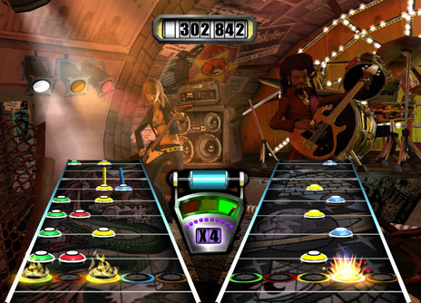
And as Wikipedia says…

Slide 22
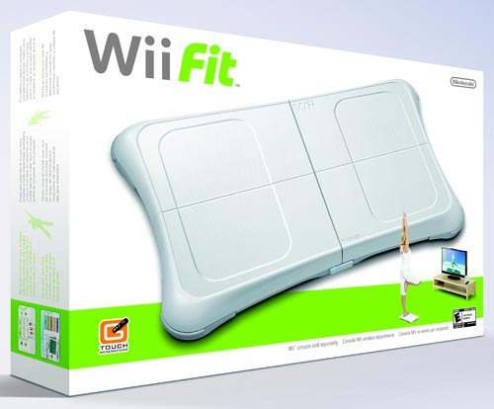
Wii Fit “Balance Board” (2007)
Currently the third best selling console game in history (among games not packaged with a console) with 22.67 million copies sold as of March 2012.
Uses Bluetooth technology and contains four pressure sensors that are used to measure the user's center of balance and weight.

Slide 23
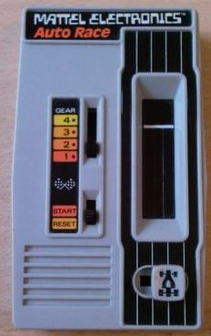
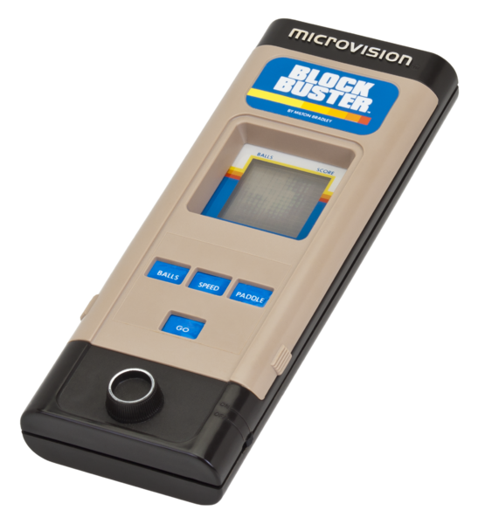
Portable Gaming
Technically, the first portable video game was Mattel’s Auto Race.
Microvision (1978) by Milton-Bradley was the very first handheld game console that used interchangeable cartridges.

Slide 24


Gunpei Yokoi
In 1979, Yokoi, traveling on a bullet train, saw a bored businessman playing with an LCD calculator by pressing the buttons.
Thinks of an idea for a watch that doubled as a miniature game machine for killing time (no pun intended)

Slide 25
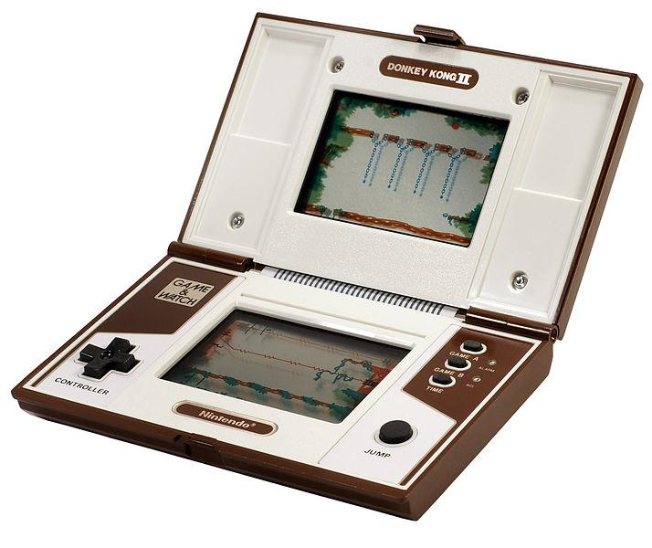
Game & Watch
Starting in 1980, Nintendo began to release a series of electronic games designed by Yokoi called the Game & Watch
Featured a single game to be played on an LCD screen in addition to a clock and an alarm. 43.4 million copies of the 59 games were sold worldwide.
By the way, this is the first use of the D-Pad. Yeah. That’s right. Nintendo invented the D-Pad.

Slide 26
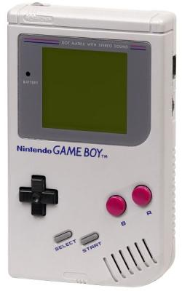
Game Boy (1989)
Next Yokoi creates the Game Boy, thereby popularizing the handheld console concept.
The Game Boy and Game Boy Color combined have sold 118.69 million units worldwide. Upon its release in the United States, it sold its entire shipment of one million units within weeks.
Nintendo Gameboy Commercial - YouTube

Slide 27
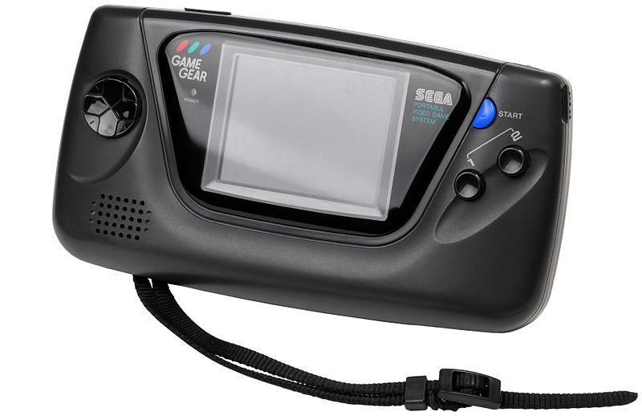
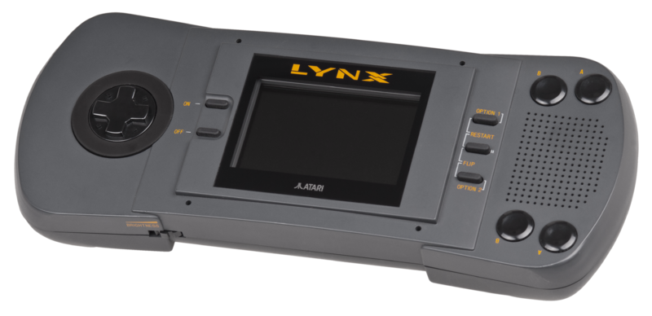
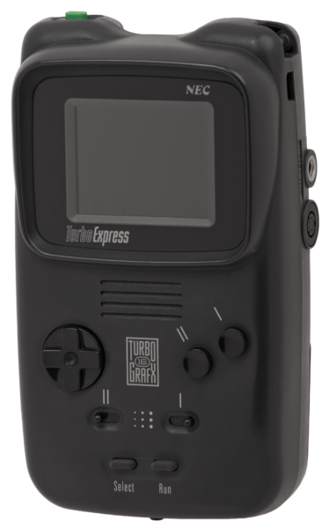
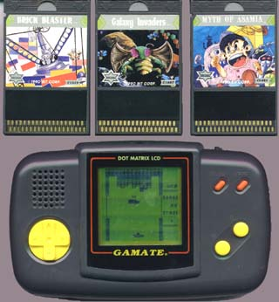
Sega GameGear (1990): 8-bit: $150
Atari Lynx (1989): 16-bit: $180
Right: NEC’s Turbo Express (1990): “16-bit”: $250
Left: many independents developed their own handhelds

Slide 28
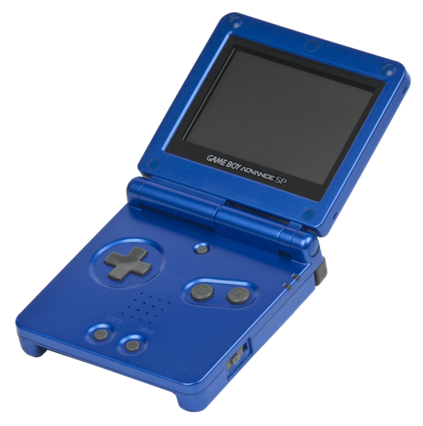
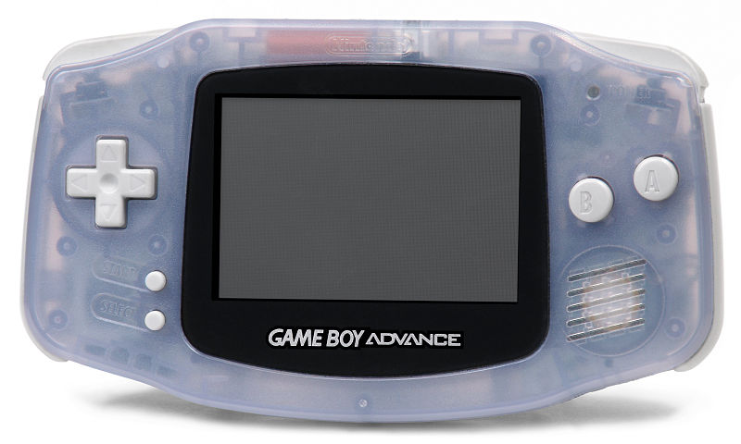
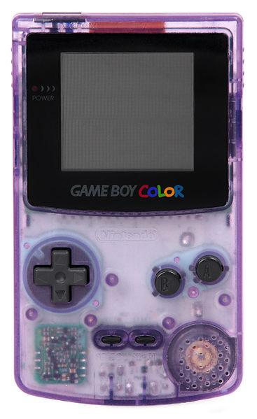
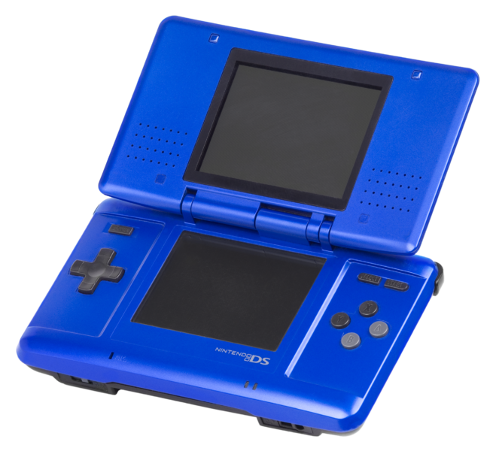
Nintendo Dominates
Re-design after re-design and price drop after price drop (not unlike the iPod).
It also doesn’t hurt to have great games.
Game Boy Advance (1998) (2003)
Nintendo DS (2004)
Game Boy Colour (1998)

Slide 29

Motion Sensor Technology
The Wii was conceived in 2001, as the Nintendo GameCube was first seeing release.
According to Shigeru Miyamoto, the concept involved focusing on a new form of player interaction. "The consensus was that power isn't everything for a console. Too many powerful consoles can't coexist. It's like having only ferocious dinosaurs. They might fight and hasten their own extinction.”

Slide 30
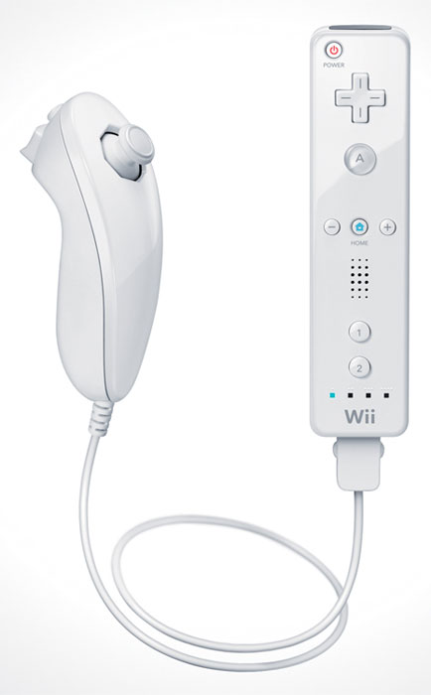

Tech
“The Wii Remote is the primary controller for the console. It uses a combination of built-in accelerometers and infrared detection to sense its position in 3D space when pointed at the LEDs within the Sensor Bar.” (wikipedia)
Or to put it another way: it’s a product of freakin’ amazing designers!

Slide 31
Marketing: “Revolution” to “Wii”
Originally called Revolution. Nintendo renames it Wii:
“Wii sounds like 'we', which emphasizes that the console is for everyone. Wii can easily be remembered by people around the world, no matter what language they speak. No confusion.”
The press and developers react negatively! A HUGE deal is made out of this name change. Turns out everybody (except Nintendo) was wrong.

Slide 32
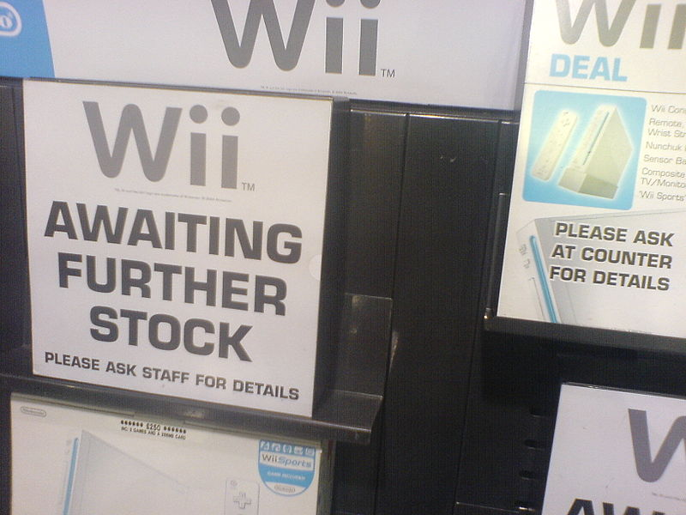
Wii Reception
Launched in 2006 for $250.
Sells 600,000 in 8 days. Makes $190 million in first week.
Hardcore gamers scoffed (and still do) at it, but the Wii redefined gaming: both in terms of technology and demographics.

Slide 33
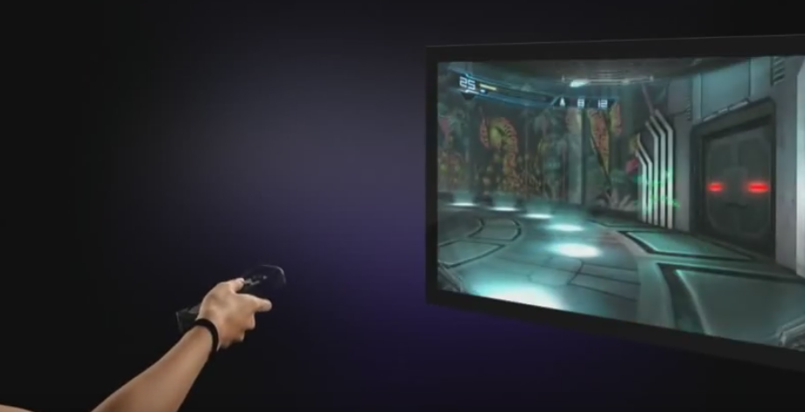
Motion Gaming?
Immersive or distracting and unnecessary?
Metroid: Other M control demo - YouTube

Slide 34
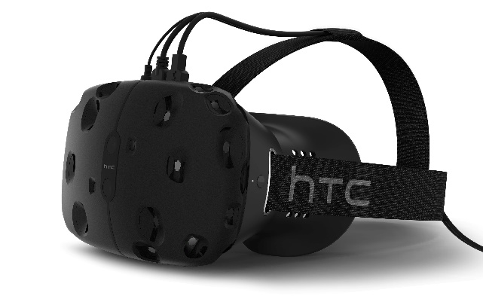
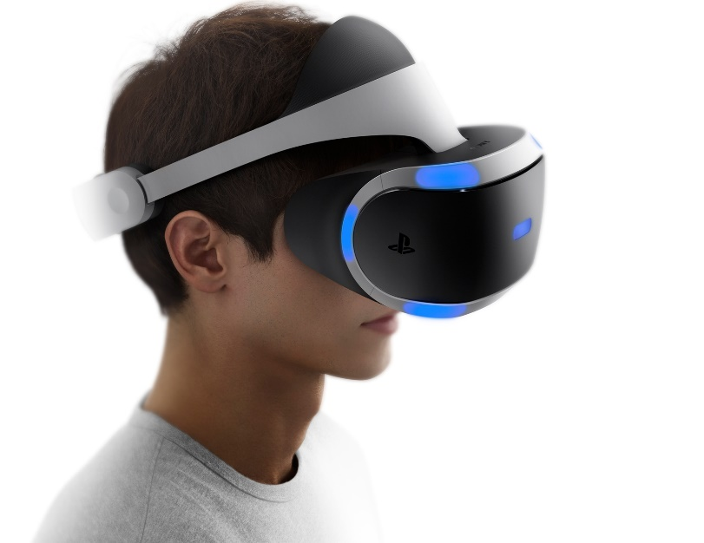
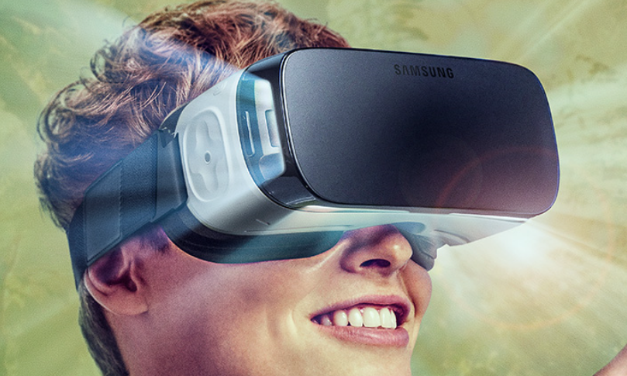
VR Headsets
HTC Vive (created with VALVE)
Gear VR (powered by Oculus): Samsung--$100.
Sony PlayStation VR: Sony (obviously)—probably $300-400bucks
Gear VR Commercial

Slide 35
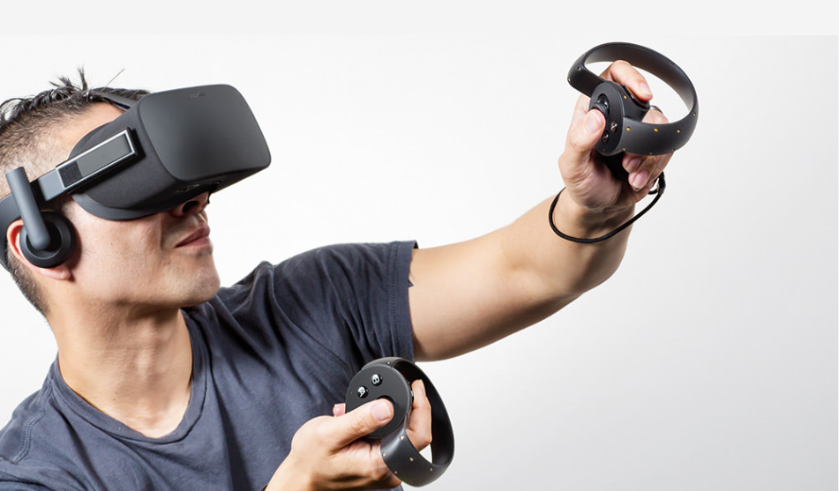
Oculus Rift and Touch

Slide 36
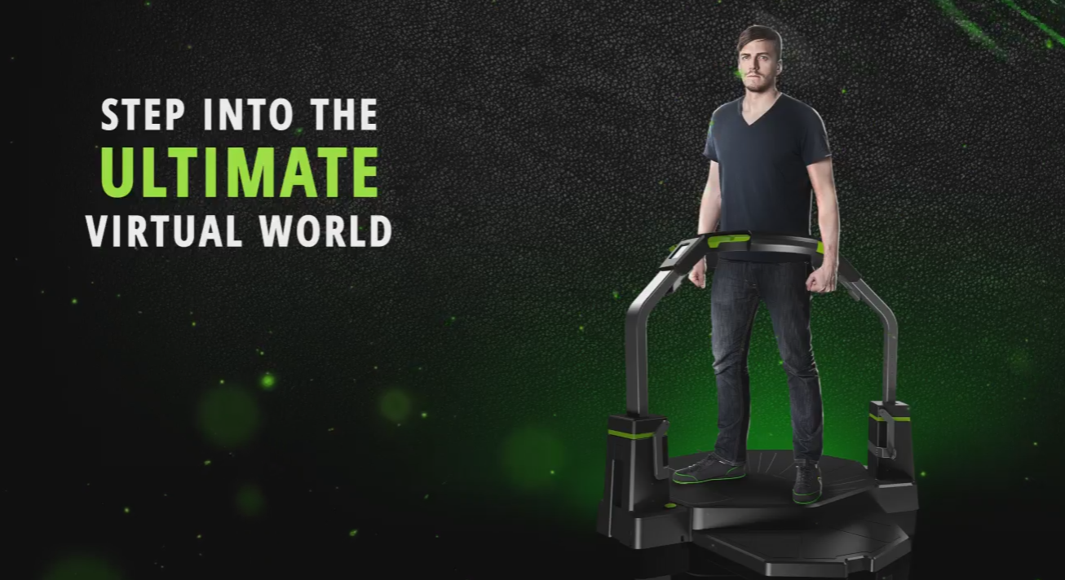

Virtuix Omni ($700)
Virtuix Omni
…but what about sprinting?

Slide 37
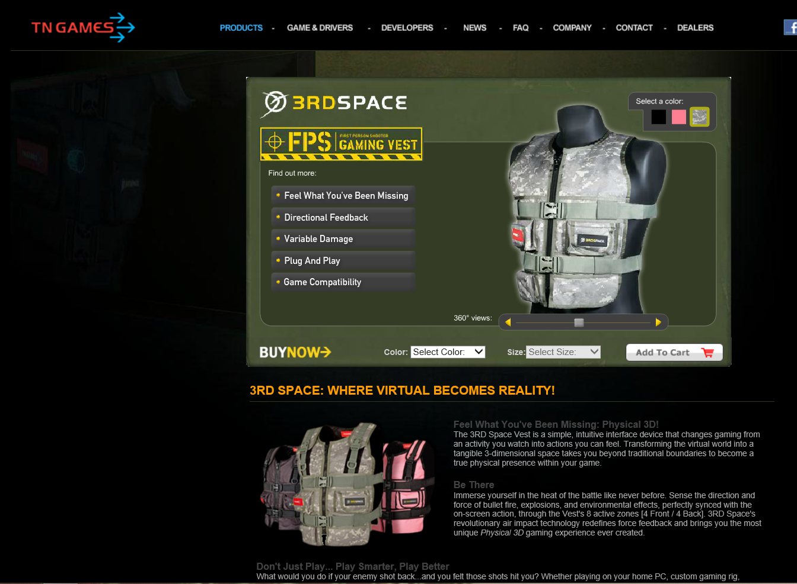
TN Games | Tactile Gaming Vest - PC Gaming Hardware & Accessories with Physical 3D

Slide 38
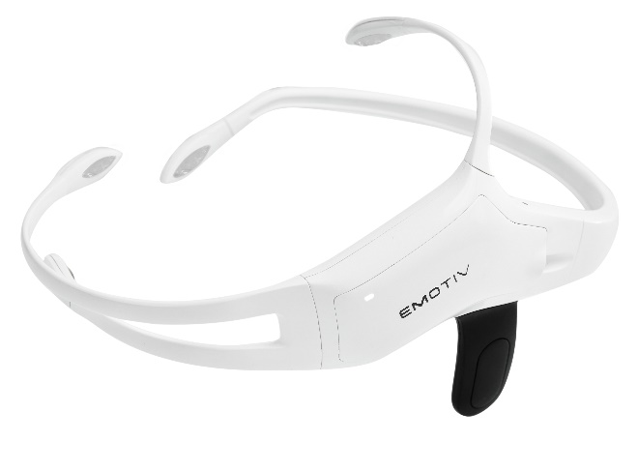



Emotiv Insight Headset ($400)

Slide 39
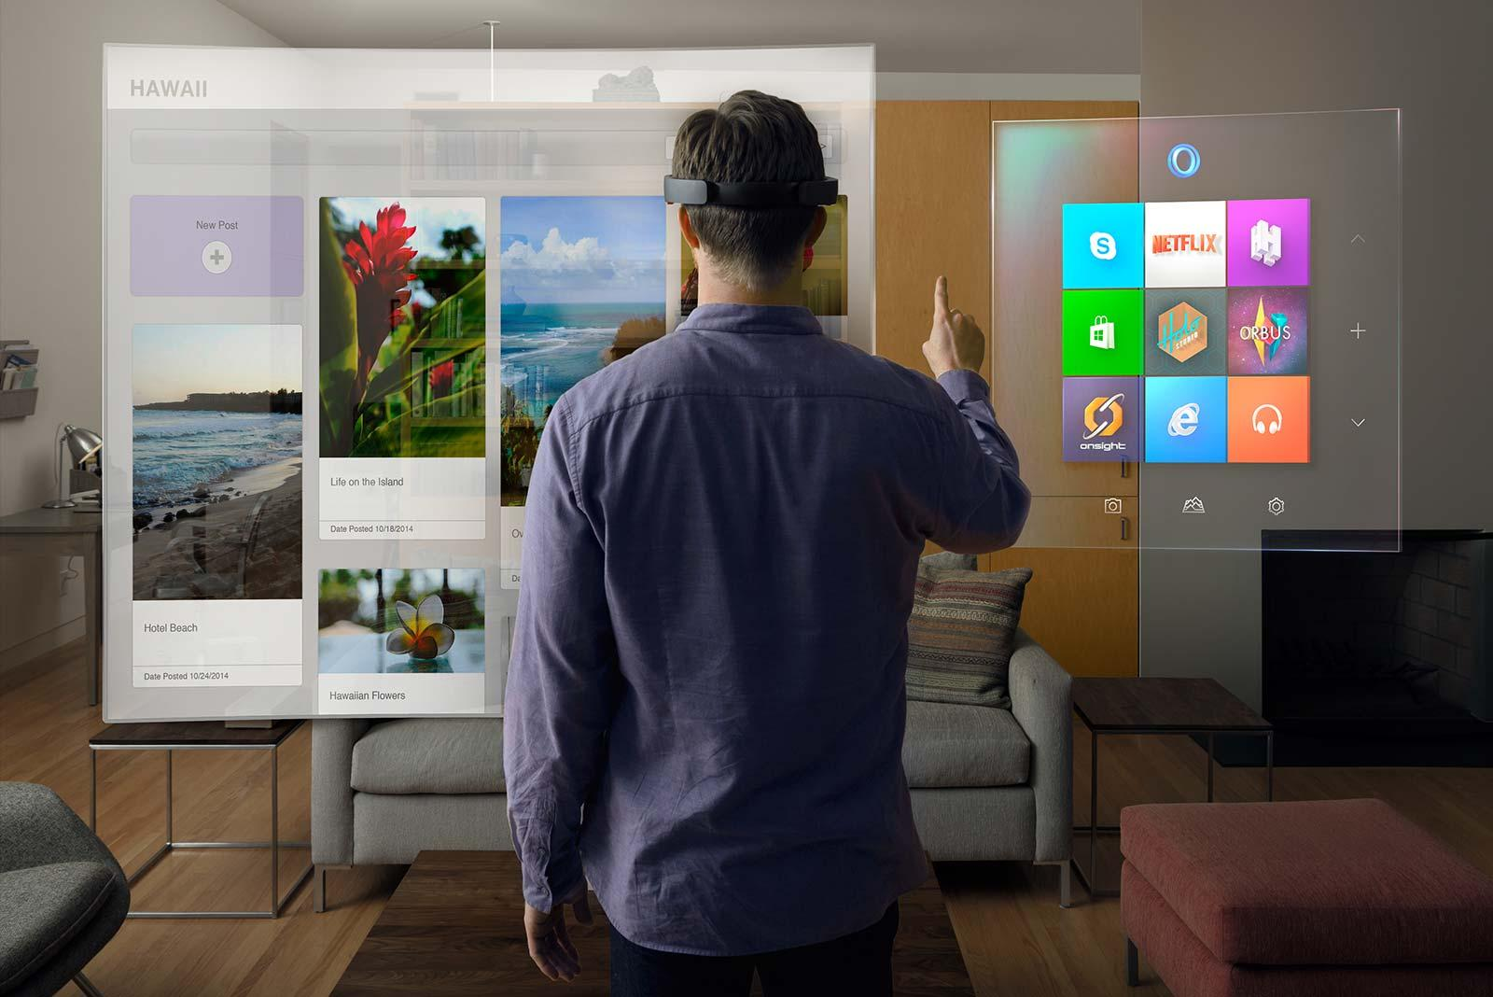
Windows Holographic
Windows Holographic Trailer

Slide 40

Augmented Reality (AR)
Augmented reality allows video game players to experience digital game play in a real world environment.
Most popular example by far was Pokémon Go: 500 millions downloads worldwide.

Slide 41
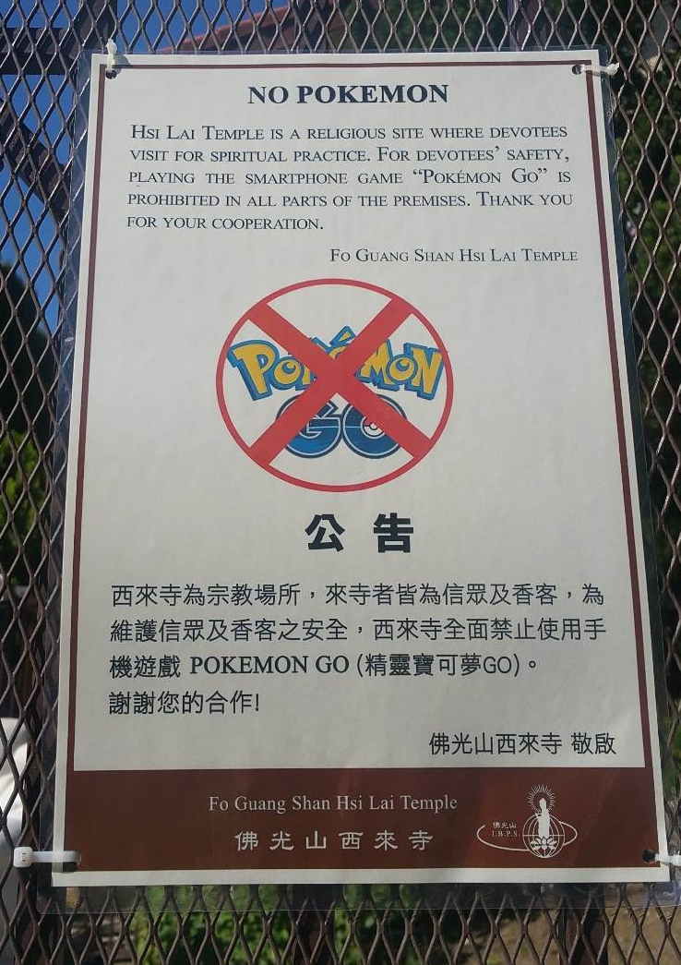
Pokémon Go: A full-fledged Global Sensation
The Good: Exercise, fresh air, the outdoors, socializing with others, tourism, damn fun!
The Bad: Addictive, trespassing, walking into traffic, inappropriate places (ie: cemeteries), obstructing real world services (ie: police, fire fighters), unnecessary crowding.

Slide 42

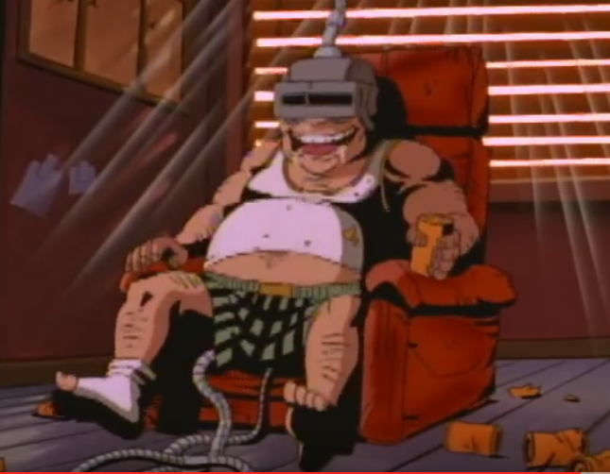
Ethical Concerns?
We just discussed race, violence, and sexism.
We also know that Vgs are an “active” medium.
What happens when you make them even more “real?”
Concerns?

Slide 43


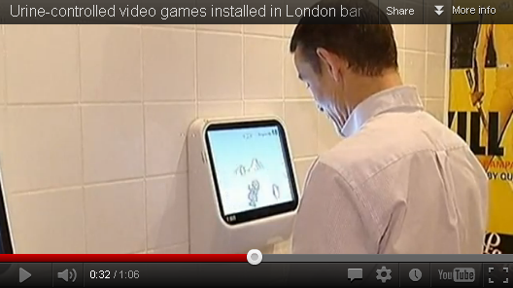

Gamification
“Controversial” (?) idea of using real-life games and video game principles to influence societal behavior (from consumerism to activism)
Urine-controlled video games installed in London bar - YouTube

Slide 44

Benefits?
improve user engagement
organizational productivity
Learning
employee recruitment and evaluation
ease of use and usefulness of systems
Increase physical exercise
Decrease traffic violations
Decrease voter apathy

Slide 45

Ribbon Hero (MS word game-based Tutorial)

Slide 46


Slide 47
Concerns?
Benefits corporations more than people?
Ian Bogost has referred to the term as a marketing fad and suggests "exploitationware" as a better term.
Jane McGonigal has distanced her work from the label gamification, listing rewards outside of gameplay as the central idea of gamification.

